Slide 1
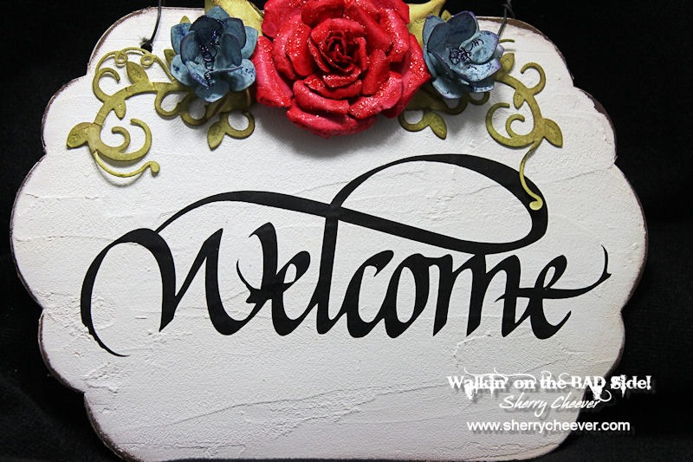

Slide 2
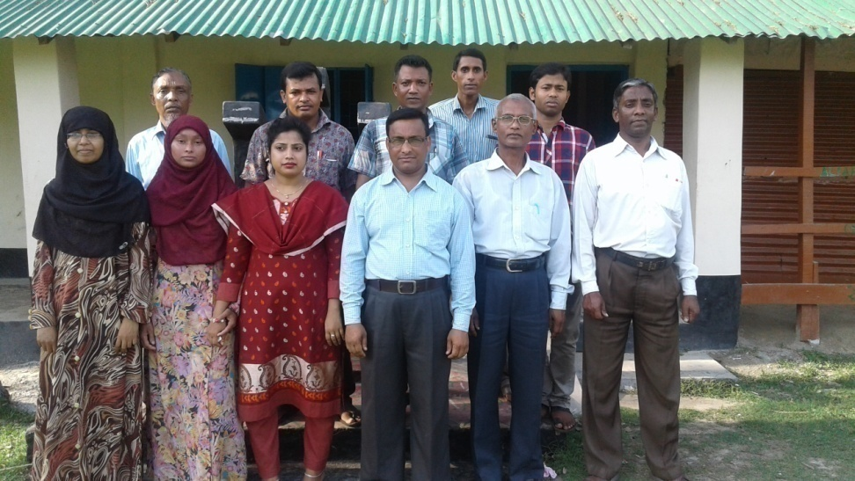
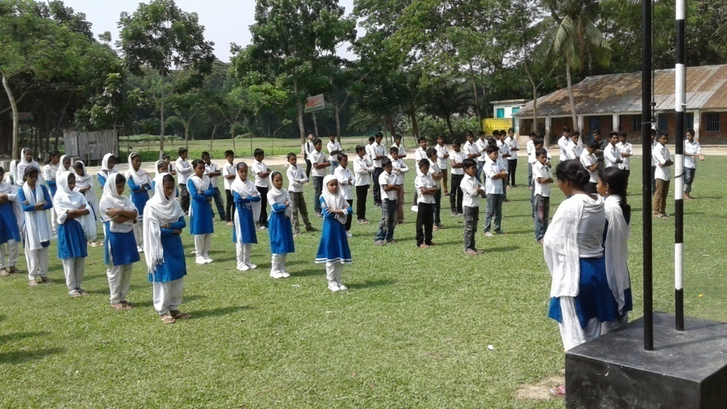
SCHOOL IDENTITY

Slide 3
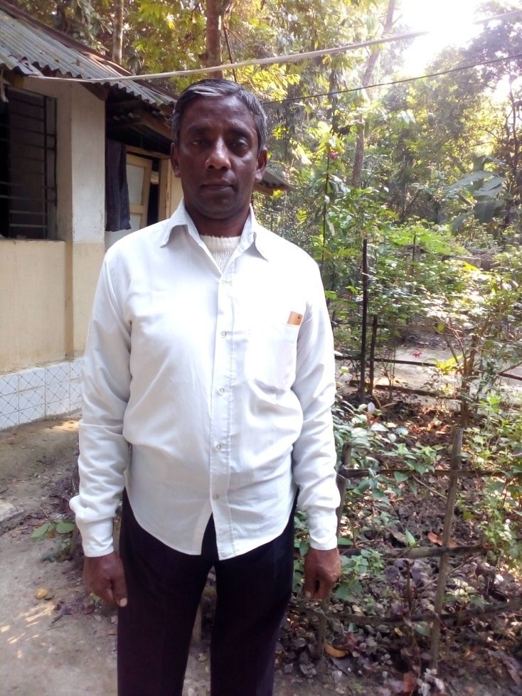
TEACHER IDENTITY
Shanti Ranjan Chakraborty
Assistant Teacher,
Shanuher M A High School,Ujirpur,Barisal.Mobile-01715485221
shanti02266@gmail.com

Slide 4
Class-6-10
English 1st Paper
Writing Test
Time: 50Min.
Date:30/09/2017

Slide 5
Let us enjoy some images and guess what they express

Slide 6


Slide 7


Slide 8
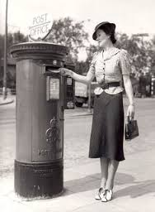

Slide 9
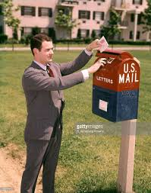

Slide 10
Today’s lesson is letter writing

Slide 11
There are two kinds of letters
Formal Letter
Informal Letter

Slide 12
There are six parts in an informal letter
They are-
1. Heading
2. Salutation
3. Body of the letter
4. Subscription
5. Signature
6. Superscription

Slide 13
Parts of Letter
Heading
Salutation
Body
Subscription
Signature
Superscription

Slide 14
1.Heading
22 April,2017
Shanuher, Ujirpur,
Barisal.

Slide 15
2.Salutation
My dear Tushar,

Slide 16
3.Body of the letter
At first take my cordial love . I hope you are well by the grace of God. I received your sweet letter yesterday. In your letter, you have wanted to know about my preparation . You will be very glad to know that I have prepared myself very well . I have already revised all of my subjects twice or thrice. English is said to be a difficult subject. But I do not think so. Rather it is a very interesting and easy subject to me. Please, pray to God so that I can make a brilliant result in the examination.
No more today. More when we met again. I am well. Hope, you are all ok. With best regard to you all.

Slide 17
4.Subscription
Your loving friend

Slide 18
5.Signature
Antara Mondal

Slide 19
6.Superscription
From, Antara Mondal Village: Shulpur Post office: Shikarpur-Nimtola-1540 P.S: Sirajdikhan District: Munshiganj Bangladesh
Stamp
To,
Tushar Kanti Mondal
Village: Shikarpur
Post office: Shikarpur-Nimtola-1540
P.S: Sirajdikhan
District: Munshiganj
Bangladesh

Slide 20
Evaluation
1. How many kinds of letters?
2. How many parts are there in a letter?
3. What is the main part of a letter?
4. When does a letter become a dead letter ?

Slide 21
Group Work
Write a formal letter
Group- Padma
Write an informal letter
Group- Meghna

Slide 22
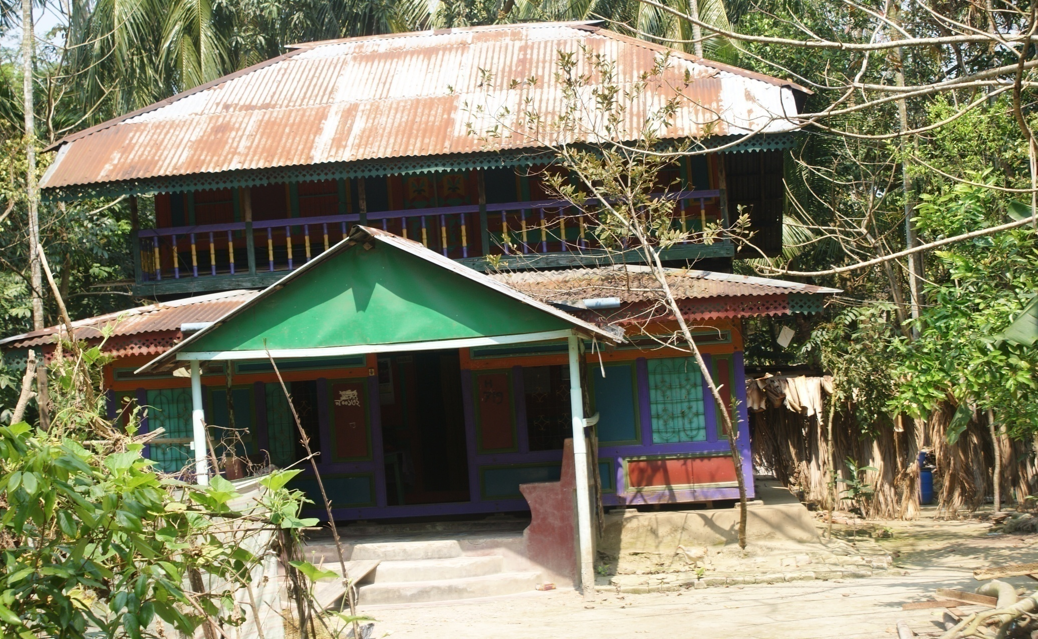
Home work
Write a letter according to the rules of a formal letter

Slide 23


Thanks to all

Slide 24
Learning outcome
At the end of the lesson the students will be able to----
Narrate formal and informal letters.
Write formal and informal letters.
Know the parts of a letter
identified of the different parts of a letter

